Slide 1
Cadet Mission Brief SAMPLE/TEMPLATE
This is a sample template Cadet Mission Briefing that includes all the mandatory briefing items.
Briefing should be well practiced and polished.
It is understandable that many of the regular/routine type things a unit does may be different this year due to the COVID-19 pandemic. Units may use information from the previous school year to demonstrate cadet involvement and accomplishments in this briefing.
Notes:
As I mentioned on the previous slide, we have had a lot of success over the past three years.
Since I’ve been a part of this unit, we have earned 59 Trophies. We’ve worked very hard and it shows
Personally, I really like the things we do for each other. When one of us is having problems in a class and wants to do better, we try to find another student to tutor them. I enjoyed doing this myself.
Our Christmas Card campaign was really neat too. We felt like we really contributed by writing cards to the troops and raising their moral.
Next I am going to show you pictures of our cadets in action.

Slide 2
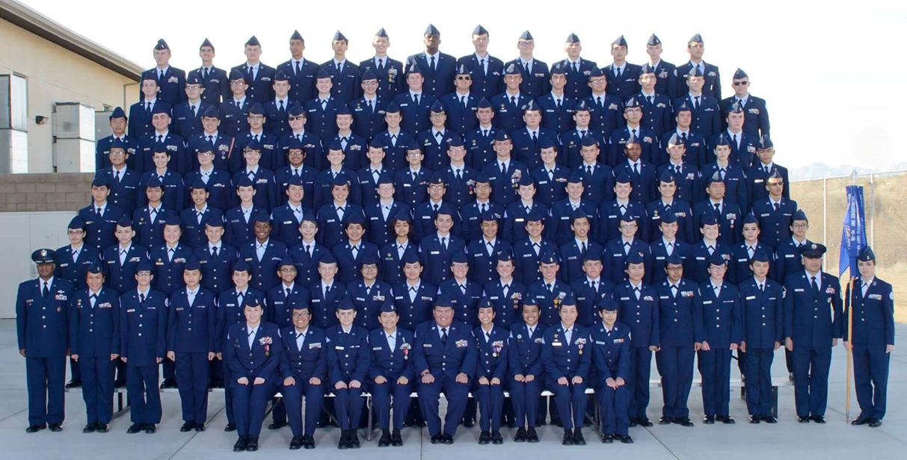
OH-999 - Any Town High School Niceville, OH Air Force Junior ROTC
Building a Culture of Excellence!
Notes:
Good Morning and welcome to North Side High School
My Name is Cadet Colonel Natalie Haynes, Commander of TN-961.

Slide 3
Overview C/Colonel Cindy L. Who
2020/2021 Unit Goals and Performance Measurements (mandatory)
Unit Wellness (mandatory)
Current Cadets Accomplishments (optional)
SY20/21 Cadets in Action (or last 12 months)
Summary of Community Service and CIA Trips (mandatory)
Show number of cadets that have participated in CIA trips
Leadership Development Requirements (LDRs) (mandatory)
How many cadets participate in LDRs
Recruiting and Retention Efforts (optional)
Other School Activities Participated in by Cadets (mandatory)
Cadet Enrichment Activities (optional)
Summary (optional)
Items marked as mandatory must be briefed. Items marked as optional are highly encouraged and relate to other UE key indicators.
Notes:
Today I will be covering these topics.

Slide 4
2020/2021 Unit Goals and Performance Measurements C/Colonel Cindy L. Who
Mandatory Goals – 1 must be academic, 1 must be recruiting/retention, and 1 must be community service participation. Brief must include performance measurements and current status of goals.
Example of Good Cadet Impact Goals
80% of the entire unit will achieve a 2.4 GPA with no flight averaging less than a 2.2 GPA
Measurement: Unit is on track to award more academic ribbons (3.0 and higher) and Top Gun awards (3.5 and higher) than at any time in the last decade. At this time every flight in the corps has a GPA of 2.49 or higher.
Increase entire Cadet Corps Physical Fitness Test average score by 10 points, from 39 in Fall 2020 to 49 by Spring 2021
Measurement : Keeping weekly fitness logs, focused on weak areas, commander and previous PT officers emphasized wellness, and dedicated time before, during, and after school to fitness activities. Corps raised its average from 39 in Fall 20 to 53.7 in Spring 21.
Notes:
These are the goals we develop for this school year
Over the past few years this unit had enjoyed many successes in drill competition and sports days. This year, when we started working on our goals we decided it was time to take this unit to the next level, so we adopted the theme “Going from Good to Great.”
As you can see our goals reflect this theme. We are still working on many of these goals. We are making good progress on our first goal. Cadets are now taking responsibility for our activities. In the past we relied too much on Chief Barron to do the work. For example, this year, Cadet Master Sergeant Kordero Gibbs took responsibility and led our successful community service project, collecting cans for the local food bank. Cadet Senior Airman Deanna Roberts spearheaded our volunteers at the local Soup Kitchen.
Our most challenging goal is meeting the state standard ACT scores. To be honest, this goal is a stretch for most of the students in this school. We felt we should emphasize personal success for our cadets though. We want to set the example for the school.

Slide 5
2020/2021 Unit Goals and Performance Measurements C/Colonel Cindy L. Who
Example of Good School Impact Goals
Each Flight will dedicate a minimum of 10 hours of service to the school
Measurement: In addition to community service, each of our flights also focused on service to our school. From the first day of our school year, our flights organized daily, weekly, and monthly plans to perform a flag ceremony every day before and after school. We maxed our goal of 10 events per flight (50 events total) by adding in our service hours to our school through environmental clean-ups, Robotics Competition service support, school team building, and raising the positive profile of our school.
Conduct 14 Middle School Visits, log 100% of CA-xxx events to keep Goal 2 Database updated for Unified School District
Measurement: APT team, PA officer and NCO has planned/scheduled all 14 visits to our feeder middle schools. The APT team has also contributed many hours to update the school and district data base that tracks every academic, athletic, service, and team event completed by our students - on track for 100% entry by the end of the school year.
Notes:
These are the goals we develop for this school year
Over the past few years this unit had enjoyed many successes in drill competition and sports days. This year, when we started working on our goals we decided it was time to take this unit to the next level, so we adopted the theme “Going from Good to Great.”
As you can see our goals reflect this theme. We are still working on many of these goals. We are making good progress on our first goal. Cadets are now taking responsibility for our activities. In the past we relied too much on Chief Barron to do the work. For example, this year, Cadet Master Sergeant Kordero Gibbs took responsibility and led our successful community service project, collecting cans for the local food bank. Cadet Senior Airman Deanna Roberts spearheaded our volunteers at the local Soup Kitchen.
Our most challenging goal is meeting the state standard ACT scores. To be honest, this goal is a stretch for most of the students in this school. We felt we should emphasize personal success for our cadets though. We want to set the example for the school.

Slide 6
2020/2120 Unit Goals and Performance Measurements C/Colonel Cindy L. Who
Example of Good Community Impact Goals
Cadet Corps will average 14 hours of service per cadet from 11 Apr 2020 to 10 Apr 2021
Measurement: In April 2020 to June 2021 our corps achieved 163 hours of community service, and in August 2020 to April 2021 we achieved 2052 hours of community service with a total amount of 2215 hours. That’s 241 hours above our goal. We are now at 15.6 service hours per cadet.
95% of the Corps will participate in community parades and Special Teams will perform in a combined minimum of 20 events
Measurement: Our corps had an attendance of 97% for participation in the Veterans Day Parade and a 100% attendance from our Alpha flight which consists of our juniors and seniors. At this time special teams have planned/scheduled events to meet their goal of 20 events this year. These events include parades, local ceremonies, charities, civic and veteran organizations, as well as different events within our school.
Notes:
These are the goals we develop for this school year
Over the past few years this unit had enjoyed many successes in drill competition and sports days. This year, when we started working on our goals we decided it was time to take this unit to the next level, so we adopted the theme “Going from Good to Great.”
As you can see our goals reflect this theme. We are still working on many of these goals. We are making good progress on our first goal. Cadets are now taking responsibility for our activities. In the past we relied too much on Chief Barron to do the work. For example, this year, Cadet Master Sergeant Kordero Gibbs took responsibility and led our successful community service project, collecting cans for the local food bank. Cadet Senior Airman Deanna Roberts spearheaded our volunteers at the local Soup Kitchen.
Our most challenging goal is meeting the state standard ACT scores. To be honest, this goal is a stretch for most of the students in this school. We felt we should emphasize personal success for our cadets though. We want to set the example for the school.

Slide 7
Wellness C/1Lt Gordon, C/2Lt Johnson, and C/MSgt Elliot
141 Cadets Participating
All 5 PFT events accomplished and entered into PFT Assessments (Mass) in WINGS - 3 Oct 20
- Bronze Level Awards – 4 cadets
- Silver Level Awards – 1 cadet
100% accountability of all Parent Consent Forms in WINGS and hard copies on file in cadet PIF folders
1st/3rd PT Day of the Month
1 mile run and station training
2nd/4th PT Day of the Month
Team Sports
Notes:
Our Drill Team has really improved since I’ve been here. Now we are the best team in the Mid South. Part of the reason we are the best is because we practice more than anyone else. Our drill team cadets are probably the most dedicated members of our Corps of Cadets. We are setting the stage for the future. Our long term goal is to be the best in the South and one day compete at Nationals.

Slide 8
Cadet Accomplishments C/Captain Sarah Jones – Public Affairs Officer
Distinguished Unit … 7 years running
Two Cadets Selected for the AFJROTC Flight Academy
Amassed over 3,500 hours of community service (2020)
Academic Bowl Team – Phase II National Finalists (2020)
Drill Team – 5 Time National Champions in Armed Drill - earned 30 trophies at local drill competitions (2020/2021)
Initiated AFJROTC Honor Roll program and provided academic tutoring for struggling cadets (2020)
Three cadets selected for service academy scholarships
Over $3,000,000 in scholarships offered to AFJROTC Cadets (2020)
Wrote and mailed over 500 Christmas Cards to our Troops (2019)
Developed a Corps Newsletter “The Warrior”…done each Semester (2020)
Built school AFJROTC Web Page for student recruiting and education (2019)
Notes:
As I mentioned on the previous slide, we have had a lot of success over the past three years.
Since I’ve been a part of this unit, we have earned 59 Trophies. We’ve worked very hard and it shows
Personally, I really like the things we do for each other. When one of us is having problems in a class and wants to do better, we try to find another student to tutor them. I enjoyed doing this myself.
Our Christmas Card campaign was really neat too. We felt like we really contributed by writing cards to the troops and raising their moral.
Next I am going to show you pictures of our cadets in action.

Slide 9
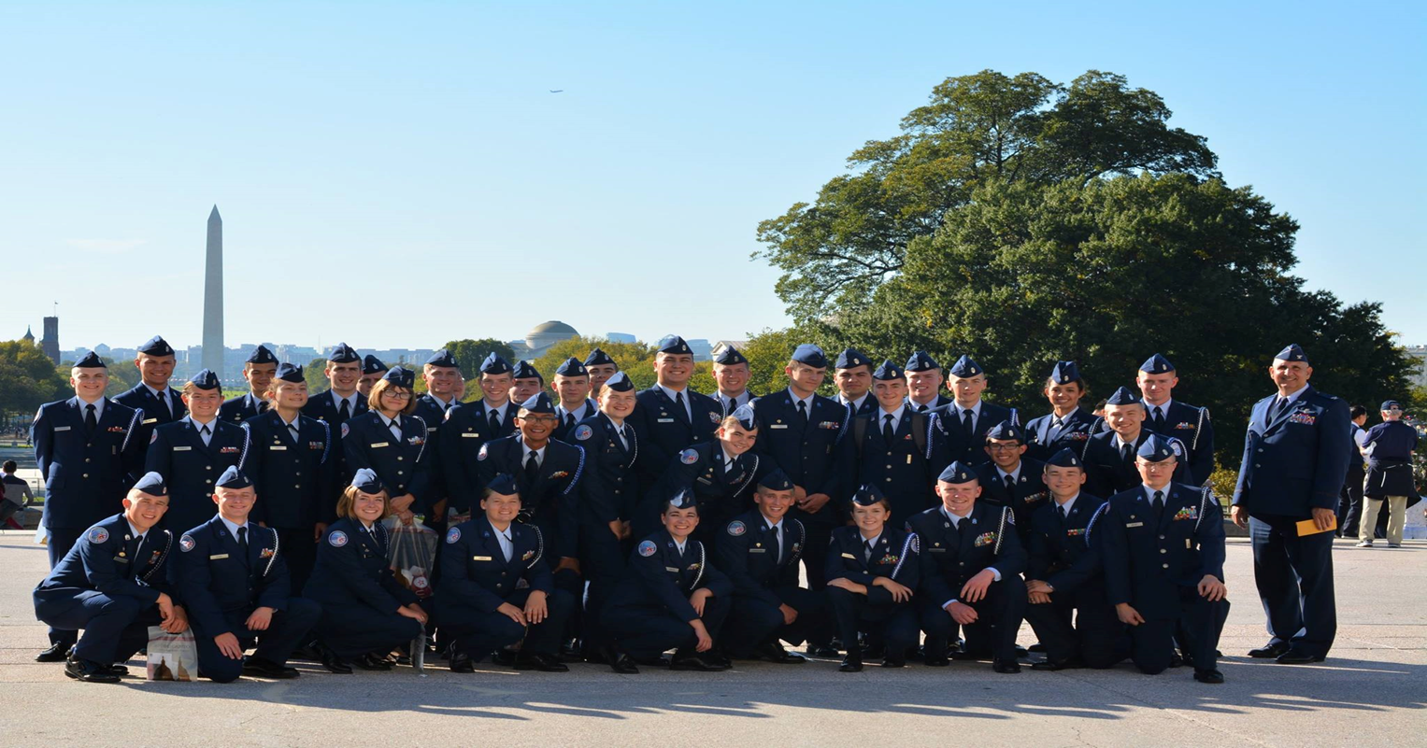
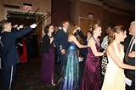
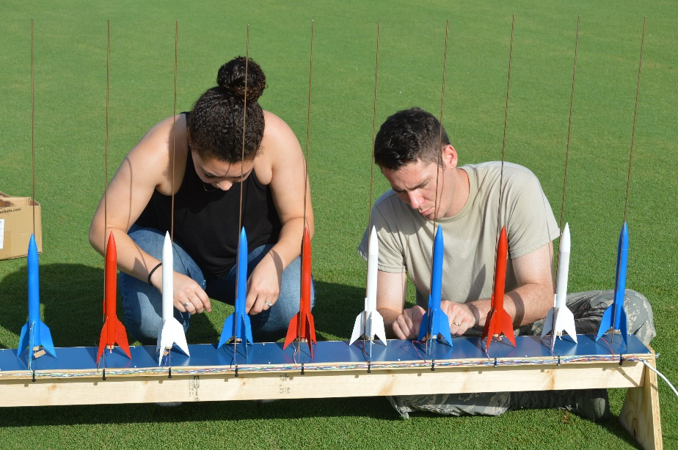
SY20/21 Cadets in Action (current photos only – talk briefly about each picture) C/SSgt Bill Smith and C/SrA Jessica Jones
2020 – Washington DC CIA Trip
2020 - Annual Military Ball
2020 – Apollo Celebration Rocket Launch
Notes:
These pictures show some of the fun things we have been doing.
Of all the pictures on this page, this one is the one I enjoyed most. We took a trip to Huntsville Alabama and saw the Space Museum there.

Slide 10
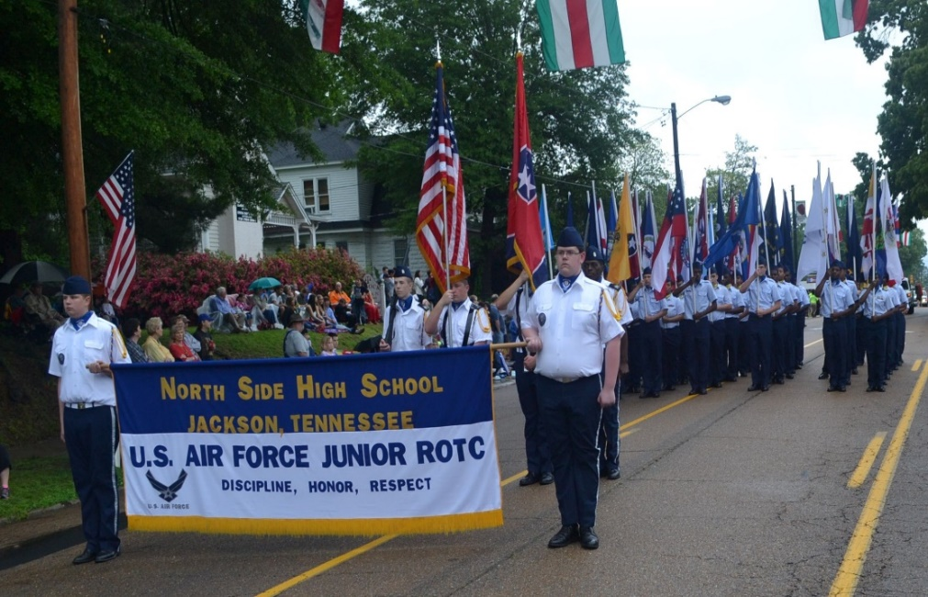
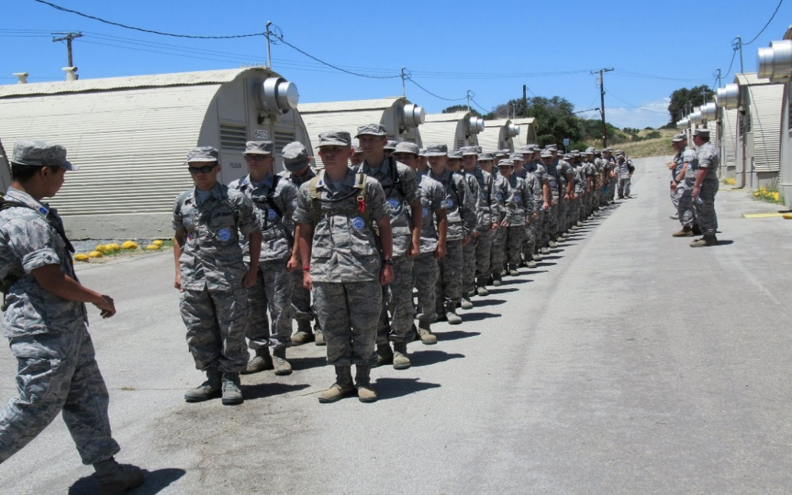
SY20/21 Cadets in Action (current photos only – talk briefly about each picture) C/SSgt Bill Smith and C/SrA Jessica Jones
2019 – Veterans Day Parade
2020 – Cadet Leadership Course
Notes:
These pictures show some of the fun things we have been doing.
Of all the pictures on this page, this one is the one I enjoyed most. We took a trip to Huntsville Alabama and saw the Space Museum there.

Slide 11
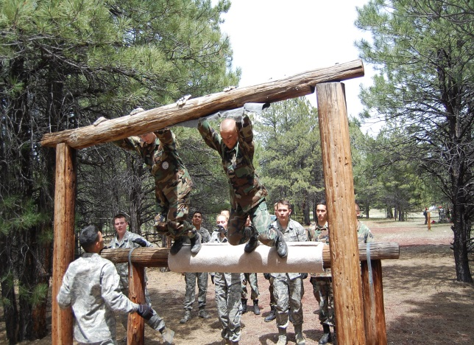
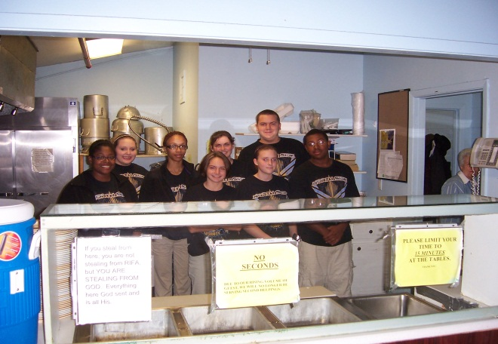
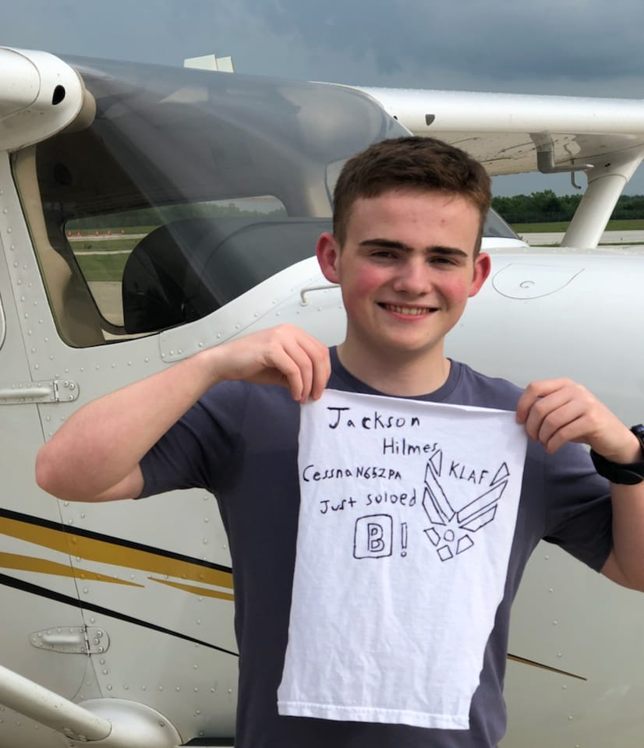
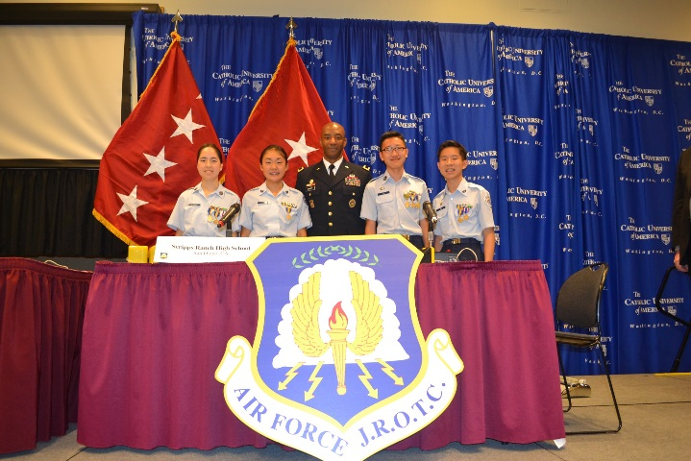
SY 20/21 Cadets in Action C/SSgt Bill Smith and C/SrA Jessica Jones
2019 - Cadet Leadership Course
2019 - Soup Kitchen Volunteers
2019 – AFJROTC Flight Academy
2019 – Cadet Jackson’s Solo Flight
2019 – National Finals Academic Bowl

Slide 12
Summary Community Service/CIA Trips C/Major Jon Doe and C/TSgt Marc Smith
Conducted 2,215 Community Service hours during SY19/20
All events loaded into WINGS
Cadets Averaged 15.6 hours per
Unit took 3 CIA Trips SY 19/20
Local Army National Guard tour – Nov 19
Washington DC – Feb 20
Visited University of Alabama Air Force ROTC – Dec 19
Cadet participation
90/141 cadets participating in CIA Trips (64% of cadets participating)
4 CIA Trips Planned for SY 20/21loaded into WINGS
Notes:
As you can see here, we have dedicated a great deal to community service. I am really proud of what we have done with the color guard. We now have local community organizations calling us to present the colors at their events. That didn’t happen when I first joined Junior ROTC. Now we are able to present the positive side of North Side High School to thousands of people each year.
But, I have to admit everything wasn’t fun. I really didn’t enjoy the Strawberry Festival Parade. It was too hot.

Slide 13
LDR Activities
STEM Based Tier 1
JLAB
Multicopter
Rocketry
StellarXplorers
Activity Based Tier 2
Competitive Drill Team
Color Guard
Marksmanship
Orienteering
Raiders/Fitness
Unit Based Tier 3
APT Team
Flag Detail
Planning Committee
Kitty Hawk Air Society
Honor Guard
Saber Team
Ki
93% of unit’s cadets participate in at least one LDR

Slide 14
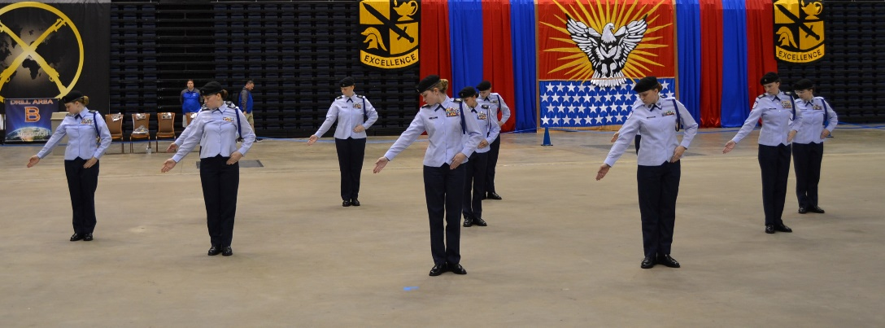
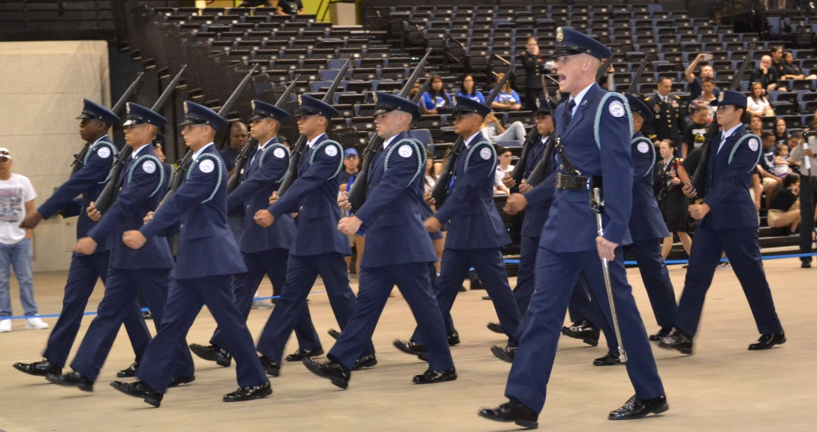
Leadership Development Requirements Drill Team – C/Lt Col Harris
44+ Cadets Participating
Won everywhere we went!
2019 - National Champions
Armed Drill
5 - Overall Championships
14 - 1st Place Trophies
6 - 2nd Place Trophies
4 - 3rd Place Trophies
All Drill Practices are loaded into WINGS
Next Drill Meet 23 Jan 2021
Notes:
Our Drill Team has really improved since I’ve been here. Now we are the best team in the Mid South. Part of the reason we are the best is because we practice more than anyone else. Our drill team cadets are probably the most dedicated members of our Corps of Cadets. We are setting the stage for the future. Our long term goal is to be the best in the South and one day compete at Nationals.

Slide 15
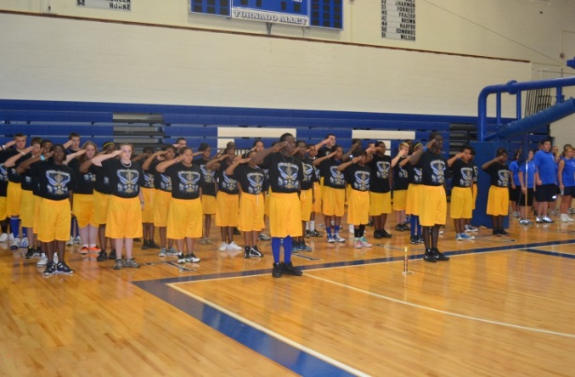
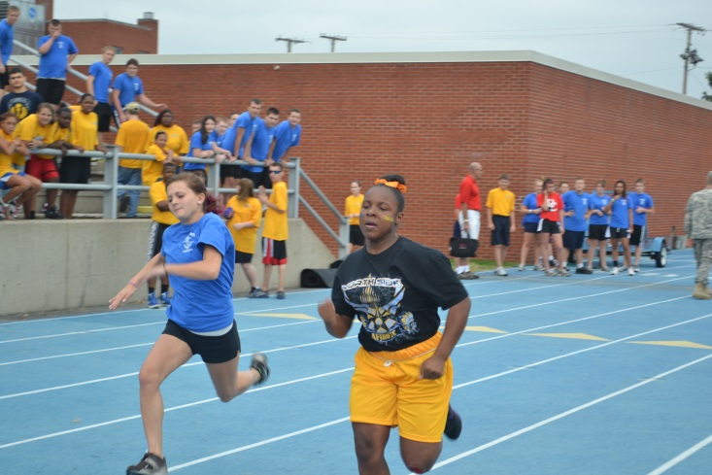
Leadership Development Requirements PT Sports Day Team – C/Major How
50+ Cadets Participating
Participated at 10 PT Sport Day Competitions
23 - 1st Place Trophies
2 - 2nd Place Trophies
5 - 3rd Place Trophies
All PT practices are loaded into WINGS
Next competition 2 Apr 2021
Notes:
We really like going to sports days. We have some very talented athletes. Our last sports day, in Paducah Kentucky was my favorite. We won almost all the events and the overall trophy. We just hosted a sport day here last Saturday.

Slide 16
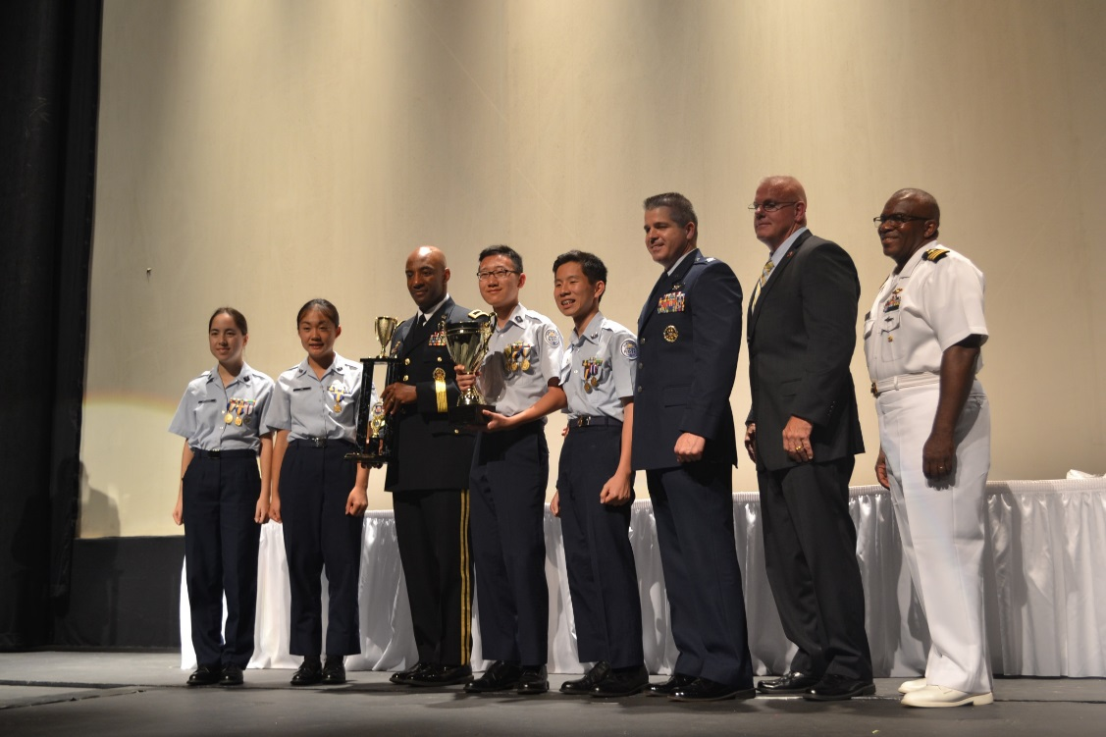
Leadership Development Requirements Academic Bowl Team – C/1Lt Miller
6 Time Finalists at Washington DC
Air Force National Champions – 14/15/16/17/18/19
Joint Service National Champions – 2016/17/18
All Academic Bowl Practices are loaded into WINGS
National Champions in Washington DC
Notes:
We really like going to sports days. We have some very talented athletes. Our last sports day, in Paducah Kentucky was my favorite. We won almost all the events and the overall trophy. We just hosted a sport day here last Saturday.

Slide 17
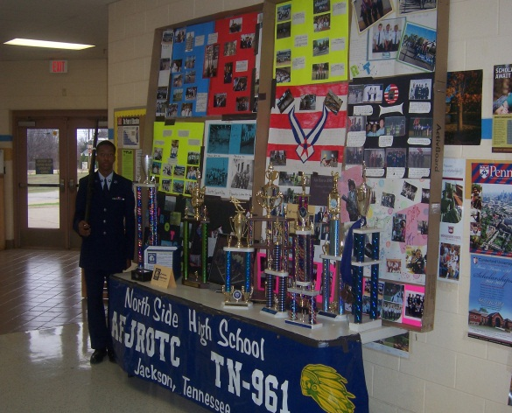
Recruiting and Retention Efforts
Recruiting: Describe what the unit is doing in the high school and feeder schools to recruit cadets
Retention: Describe what the unit is doing to retain cadets
Unit retained 65% of ASI cadets for next school year
AFJROTC Table at Freshman Orientation Night
Notes:
Drill Camps

Slide 18
Other School Activities Participated in by Cadets
Cadets on Football team: 15
Cadets on Basketball teams: 2
Cadets on Baseball/softball teams: 3
Cadets on Soccer teams: 5
Cadets on Volleyball team: 5
Cadets involved with student government: 5
President of Junior class is an AFJROTC III year cadet
Choir Members: 5
Band Members: 10
Cadets in AP Honors Classes: 15
#1/245 Sophomore is an AFJROTC II year cadet
Notes:
Drill Camps

Slide 19
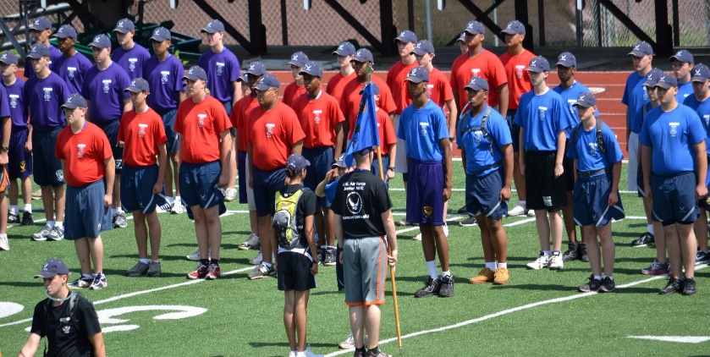
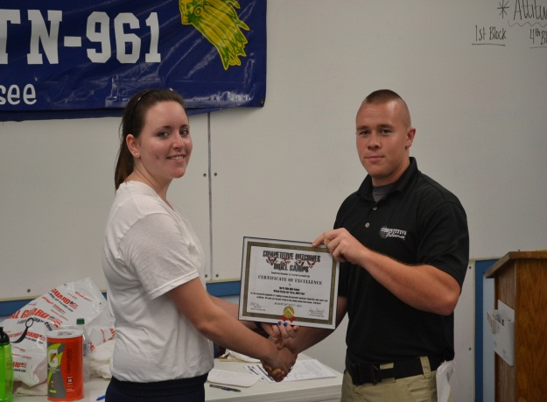
Cadet Enrichment Activities
Cadet Leadership Course
Hosted Event with 15 schools attending
130 cadets attended
10 of our cadets attended
C/MSgt Allen, C/SrA Petty, and C/SrA Smith Distinguished Graduates
Drill Camp – Taught by Competitive Outcomes
30 cadets graduated from 20 hour camp
Cadet Orientation
64 first year cadets completed 20 hour cadet orientation
Notes:
Drill Camps

Slide 20
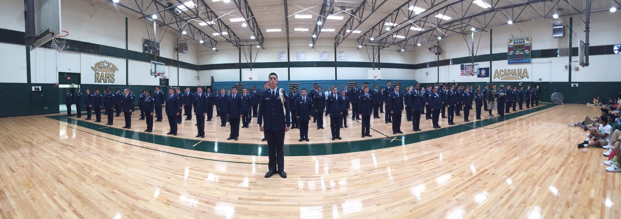
Summary (Briefer should give a brief wrap up)
We Like Here, We Love It Here,
We’ve Finally Found a Home. Hoooorah

