Slide 1
NC-804 PT GOALS
2023-24 School Year
Mid-Year Progress Check

Slide 2
PT Goals & Progress
Goals below submitted to HQ AFJROTC
Briefing HQ Inspector on 26 April 24
By the end of this school year
80% of cadets will show a 20% increase in push-ups & sit-ups (from Sept 23 to May 24)
58 cadets accomplished mid-year progress check (Sept 23 & Jan 24)
Push-ups: Jan 24 vs Sept 23
74% met goal (43 cadets); 7% improved (4 cadets); 3% same (2 cadets); 16% worse (9 cadets)
Sit-ups: Jan 24 vs Sept 23
54% met goal (31 cadets); 26% improved (15 cadets); 5% same (3 cadets); 15% worse (9 cadets)
80% of cadets will decrease 1-mile time by 10% (from Sept 23 to May 24)
57 cadets accomplished mid-year progress check (Sept 23 & Jan 24)
1-mile: Jan 24 vs Sept 23
45% met goal (26 cadets); 38% improved (22 cadets); 17% worse (10 cadets)
Notables
11 cadets earned “Star Device” for Heath & Wellness Ribbons on Jan PFT (19%)
11 cadets met goal in all 3 PFT events (19%)
All cadets improved in at least one event
All but 6 cadets improved in at least 2 events (89%)
Takeaway
Good progress toward meeting goals
Need more cardio, ab work, and continued push-ups to meet our goals
Notes:
Pushups: 58 total (43 met goal, 4 improved, 2 same, 9 worse)
Situps: 58 total (31 met goal, 15 improved, 3 same, 9 worse)
Run: 58 total (26 met goal, 22 better, 10 worse)
11 met goal on all three events (Holt, Mozingo, Smith E, Geiser, Perez, Warrick, Bernard, Davis-Sutton, Grant, Lampley, Lewis)
All but one improved in at least one event (one person remained same)
All but six improved in at least two events

Slide 3
PFT Jan 24 “Stars”
Gold (95-100 percentile)
Gomez (98 percentile) (Silver Fall Semester)
Silver (85-94 percentile)
Edwards, D (90 percentile) (Bronze Fall Semester)
Faison (87 percentile) (Bronze Fall Semester)
Ramirez (87 percentile)
Bronze (75-84 percentile)
Nicholas (83 percentile)
Britt (80 percentile) (Bronze Fall Semester – 78 percentile)
Williams, E. (80 percentile)
Worthington (78 percentile)
Bernard (77 percentile)
Perez (75 percentile)
Rowe (75 percentile) (Bronze Fall Semester -77 percentile)

Slide 4
A Flight
Last | Push-ups | Push-ups | Push-ups | Sit-ups | Sit-ups | Sit-ups | Mile Sept |  | Mile Goal (Jan) |  | Mile Actual
Name | Sept | Goal (Jan) | Actual | Sept | Goal (Jan) | Actual | min | sec | min | sec | min | sec
Holt | 15 | 18 | 25 | 22 | 26.4 | 27 | 11 | 20 | 10 | 12 | 9 | 0
Kimbrough | 40 | 48 | 40 | 39 | 46.8 | 43 | 8 | 16 | 7 | 26 | 7 | 35
Greene A. | 10 | 12 | 12 | 22 | 26.4 | 30 | 19 | 46 | 17 | 47 | 18 | 30
Mozingo | 12 | 14.4 | 17 | 25 | 30 | 30 | 19 | 46 | 17 | 47 | 14 | 45
Smith | 35 | 42 | 43 | 31 | 37.2 | 40 | 15 | 16 | 13 | 44 | 11 | 40
Smith-Johnson | 10 | 12 | 20 | 10 | 12 | 23 | 14 | 40 | 13 | 12 | 14 | 50
Wren | 24 | 28.8 | 29 | 37 | 44.4 | 41 | 12 | 27 | 11 | 12 | 11 | 59

Slide 5
B Flight
Last | Push-ups | Push-ups | Push-ups | Sit-ups | Sit-ups | Sit-ups | Mile Sept |  | Mile Goal (Jan) |  | Mile Actual
Name | Sept | Goal (Jan) | Actual | Sept | Goal (Jan) | Actual | min | sec | min | sec | min | sec
Murillo | 30 | 36 | 25 | 55 | 66 | 59 | 6 | 42 | 6 | 1 | 8 | 25
Worthington (Bronze) | 55 | 66 | 70 | 30 | 36 | 37 | 8 | 33 | 7 | 41 | 8 | 24
Benton | 36 | 43.2 | 30 | 33 | 40 | 43 | 14 | 36 | 13 | 8 | 14 | 28
Carroll | 5 | 6 | 13 | 15 | 18 | 20 | 16 | 46 | 15 | 5 | 15 | 54
Chance | 0 | 1 | 20 | 30 | 36 | 22 | 22 | 13 | 19 | 59 | 14 | 18
Davis Jr. | 10 | 12 | 15 | 36 | 43.2 | 33 | 8 | 30 | 7 | 39 | 8 | 23
Geiser | 20 | 24 | 25 | 25 | 30 | 30 | 13 | 18 | 11 | 58 | 11 | 4
Green N. | 24 | 28.8 | 26 | 10 | 12 | 23 | 14 | 36 | 13 | 8 | 14 | 30
Guilliams | 26 | 31.2 | 32 | 35 | 42 | 41 | 10 | 47 | 9 | 42 | 10 | 4
Herring | 24 | 28.8 | 26 | 33 | 39.6 | 37 | 12 | 40 | 11 | 24 | 7 | 45
Hinman | 4 | 4.8 |  | 0 | 0 |  | 13 | 9 | 11 | 50
Kelly | 20 | 24 | 15 | 29 | 34.8 | 36 | 13 | 33 | 12 | 11 | 14 | 29
McCullough | 25 | 30 | 35 | 50 | 60 | 60 | 8 | 35 | 7 | 43 | 8 | 55
Mooring | 35 | 42 | 42 | 46 | 55.2 | 55 | 9 | 48 | 8 | 49 | 9 | 30
Nicholas (Bronze) | 46 | 55.2 | 65 | 50 | 60 | 60 | 9 | 47 | 8 | 48 | 8 | 54
Perez Perez (Bronze) | 22 | 26.4 | 30 | 28 | 33.6 | 35 | 16 | 52 | 15 | 10 | 12 | 28
Rowe (Bronze) | 48 | 57.6 | 45 | 37 | 44.4 | 50 | 7 | 18 | 6 | 34 | 9 | 43
Volcy | 10 | 12 | 15 | 18 | 21.6 | 22 | 16 | 58 | 15 | 16 | 16 | 3
Warrick | 25 | 30 | 31 | 25 | 30 | 37 | 17 | 12 | 15 | 28 | 15 | 14
Smith, G | 27 | 32.4 | 22 | 43 | 51.6 | 33 | 15 | 35 | 14 | 2 | 12 | 41
Williams (Bronze) | 52 | 62.4 | 62 | 50 | 60 | 56 | 10 | 32 | 9 | 48 | 9 | 24

Slide 6
C Flight
Last | Push-ups | Push-ups | Push-ups | Sit-ups | Sit-ups | Sit-ups | Mile Sept |  | Mile Goal (Jan) |  | Mile Actual
Name | Sept | Goal (Jan) | Actual | Sept | Goal (Jan) | Actual | min | sec | min | sec | min | sec
Kornegay | 0 | 1 | 2 | 23 | 27.6 | 30 | 15 | 47 | 14 | 12 | 17 | 1
Britt (Bronze) | 30 | 36 | 31 | 38 | 45.6 | 44 | 11 | 40 | 10 | 30 | 11 | 19
Atkinson | 20 | 24 | 15 | 31 | 38 | 34 | 19 | 32 | 17 | 34 | 17 | 1
Bielby | 10 | 12 | 15 | 34 | 40.8 | 39 | 14 | 32 | 13 | 4 | 14 | 30
Brown | 8 | 9.6 | 2 | 20 | 24 | 26 | 20 | 53 | 18 | 47 | 18 | 46
Cina | 5 | 6 | 6 | 5 | 6 | 5 | 19 | 57 | 17 | 57 | 19 | 6
Dillard | 7 | 8.4 | 20 | 39 | 46.8 | 38 | 13 | 26 | 12 | 5 | 11 | 16
Guevara | 7 | 8.4 | 12 | 25 | 30 | 25 | 17 | 17 | 15 | 33 | 15 | 30
Hyman | 7 | 8.4 | 13 | 24 | 28.8 | 28 | 19 | 19 | 17 | 23 | 14 | 57
James | 0 | 1 | 1 | 19 | 22.8 | 25 | 20 | 45 | 18 | 40 | 18 | 47
Pierce | 9 | 10.8 | 11 | 24 | 28.8 | 25 | 17 | 17 | 15 | 33 | 17 | 41
Pressley | 10 | 12 | 13 | 22 | 26.4 | 26 | 15 | 19 | 13 | 47 | 14 | 58
Bryant (New-Jan) | 0 | 1 |  | 19 | 22.8 |  | 23 | 8 | 18 | 44
Joseph (New- Jan) | 48 | 57.6 |  | 31 | 37.2 |  | 8 | 4 | 7 | 15
Lewis, A. (New- Jan) | 20 | 24 |  | 27 | 32.4 |  | 21 | 5 | 18 | 58

Slide 7
D Flight
Last | Push-ups | Push-ups | Push-ups | Sit-ups | Sit-ups | Sit-ups | Mile Sept |  | Mile Goal (Jan) |  | Mile Actual
Name | Sept | Goal (Jan) | Actual | Sept | Goal (Jan) | Actual | min | sec | min | sec | min | sec
Chapman | 50 | 60 | 65 | 54 | 64.8 | 44 | 10 | 52 | 9 | 46 | 11 | 9
Faison | 34 | 40.8 | 41 | 50 | 60 | 43 | 13 | 0 | 11 | 42 | 11 | 29
Gomez | 33 | 39.6 | 60 | 38 | 45.6 | 50 | 9 | 2 | 8 | 7 | 8 | 41
Jeffrey | 52 | 62.4 | 63 | 45 | 54 | 40 | 10 | 43 | 9 | 38 | 9 | 21
Belmer | 16 | 19.2 | 4 | 0 | 1 | 25 | 23 | 30 | 21 | 9 | 21 | 8
Bernard | 23 | 27.6 | 33 | 39 | 46.8 | 49 | 20 | 14 | 18 | 12 | 8 | 23
Davis-Sutton | 10 | 12 | 16 | 8 | 9.6 | 23 | 25 | 40 | 23 | 6 | 21 | 22
Edwards D. | 17 | 20.4 | 22 | 36 | 43.2 | 45 | 10 | 28 | 9 | 25 | 9 | 46
Fruck | 26 | 31.2 | 32 | 35 | 42 | 39 | 12 | 26 | 11 | 11 | 11 | 17
Grant, Avon | 20 | 24 | 25 | 30 | 36 | 38 | 15 | 57 | 14 | 21 | 12 | 30
Kinley | 0 | 1 | 2 | 24 | 28.8 | 27 | 15 | 57 | 14 | 21 | 12 | 30
Lampley | 4 | 4.8 | 9 | 22 | 26.4 | 30 | 15 | 11 | 13 | 39 | 12 | 59
Lewis | 2 | 2.4 | 4 | 23 | 27.6 | 30 | 15 | 57 | 14 | 21 | 13 | 44
Martinez Fernandez | 12 | 14.4 | 17 | 29 | 34.8 | 23 | 17 | 12 | 15 | 28 | 17 | 14
Moore | 24 | 28.8 | 29 | 33 | 39.6 | 40 | 11 | 39 | 10 | 29 | 13 | 25
Perez Lorenzo | 5 | 6 | 3 | 13 | 15.6 | 15 | 18 | 23 | 16 | 32 | 18 | 12
Swinson | 21 | 25.2 | 21 | 35 | 42 | 35 | 17 | 27 | 15 | 42 | 14 | 20
Thompson | 14 | 16.8 | 17 | 27 | 32.4 | 26 | 15 | 27 | 13 | 54 | 12 | 15
Tyndall | 18 | 21.6 | 21 | 27 | 32.4 | 31 | 13 | 7 | 11 | 48 | 12 | 15
Barfield (New-Jan) | 23 | 27.6 |  | 30 | 36 |  | 20 | 0 | 18 | 0
Ramirez (New-Jan) (Silver) | 30 | 36 |  | 37 | 44.4 |  | 10 | 15 | 9 | 13

Slide 8
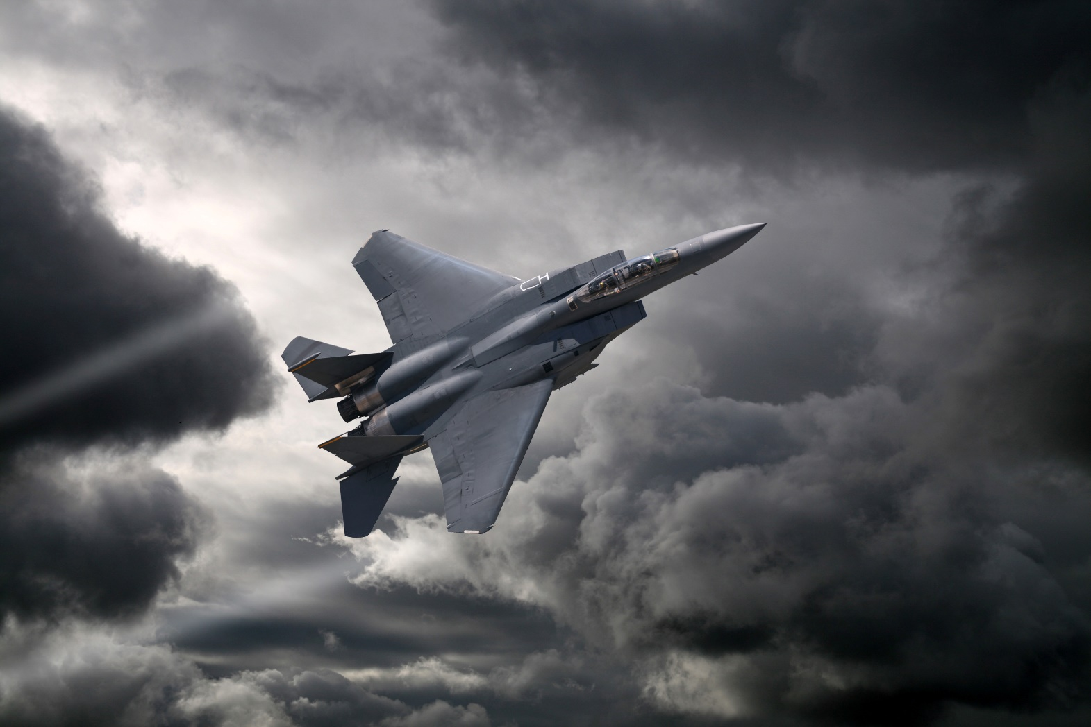
Questions?

