Slide 1
Info Before First Uniform Day

Slide 2
Light Blue SS Shirt
Only piece of blue uniform can put into washing machine/dryer
Read washing/drying instruction label
Remove immediately at end of drying; hang and shape
Do NOT button the top button unless you wear a tie/tie tab.
Males: Plain white V-neck or athletic style tank top undershirt will be worn under the shirt
Your shirt should be:
Neatly pressed
Lint, stain and cable free
Look professional at all times
Neatly tucked into the trousers at all times (military tuck)

Slide 3
Light Blue SS Shirt - Cont
Military tuck
Perform the military tuck by:
Pinching the sides of the shirt at the seams
Then fold the excess material from the back of the shirt under the excess material from the front of the shirt.
It should look like this when done:

Slide 4
Nametag Male shirts (one with pockets)
Blue plastic with the white lettering
Name tag will be:
Centered, resting on, but not over the edge of the pleated pocket on the wearer’s right

Slide 5
Nametag Female shirts (one without pockets)
Blue plastic with the white lettering
Name tag will be:
On right side
Centered
Parallel to ground when worn
Within 1.5” higher/lower than topmost exposed button

Slide 6
Rank Enlisted
Bottom part of torch points to tip
of collar
Centered
Side to side
Top to bottom

Slide 7
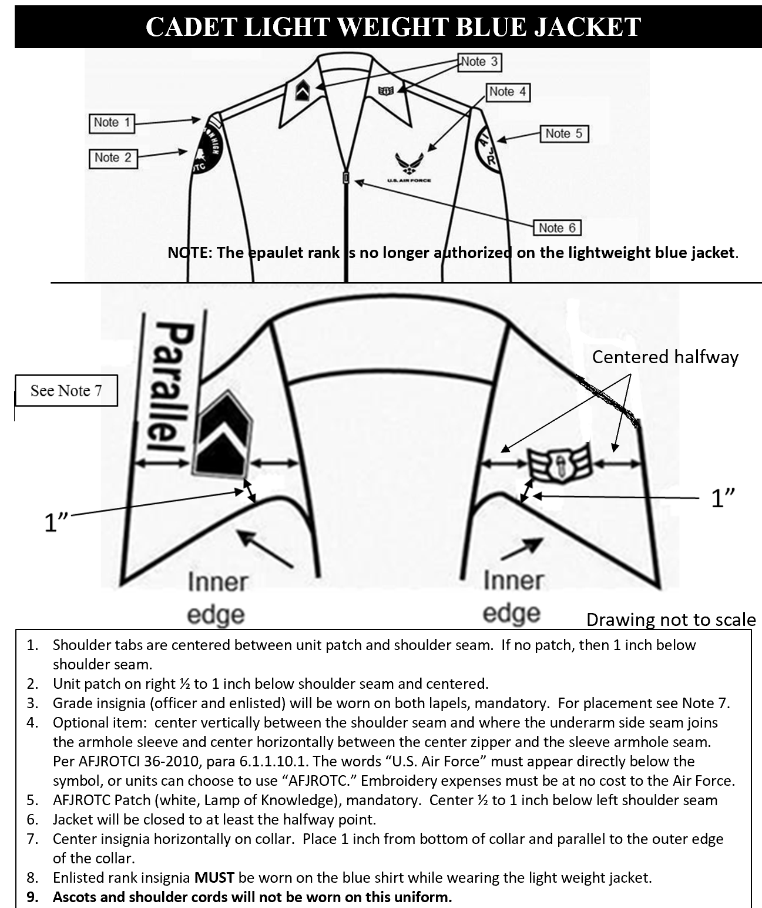
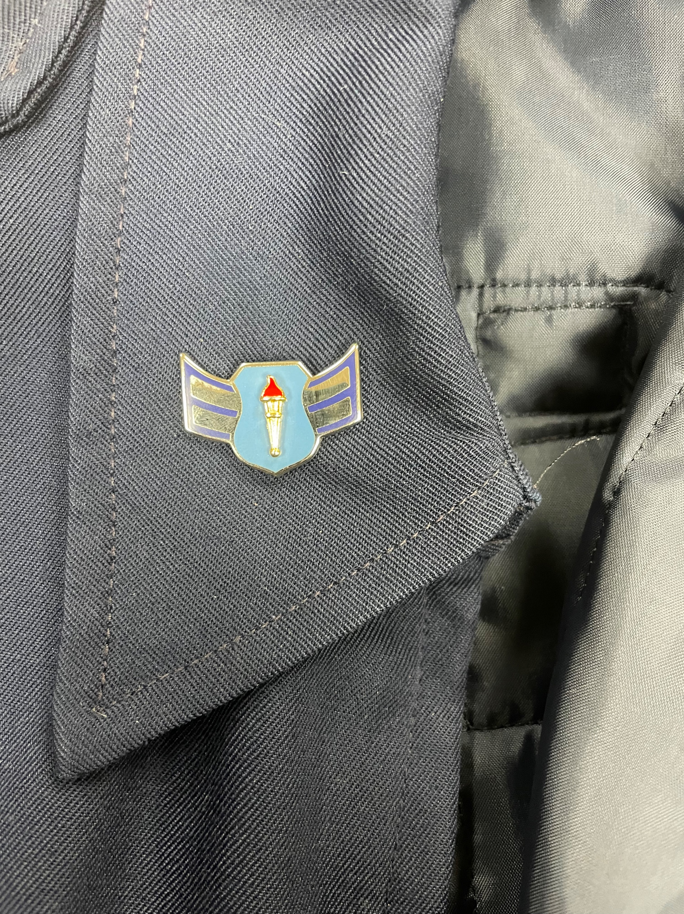
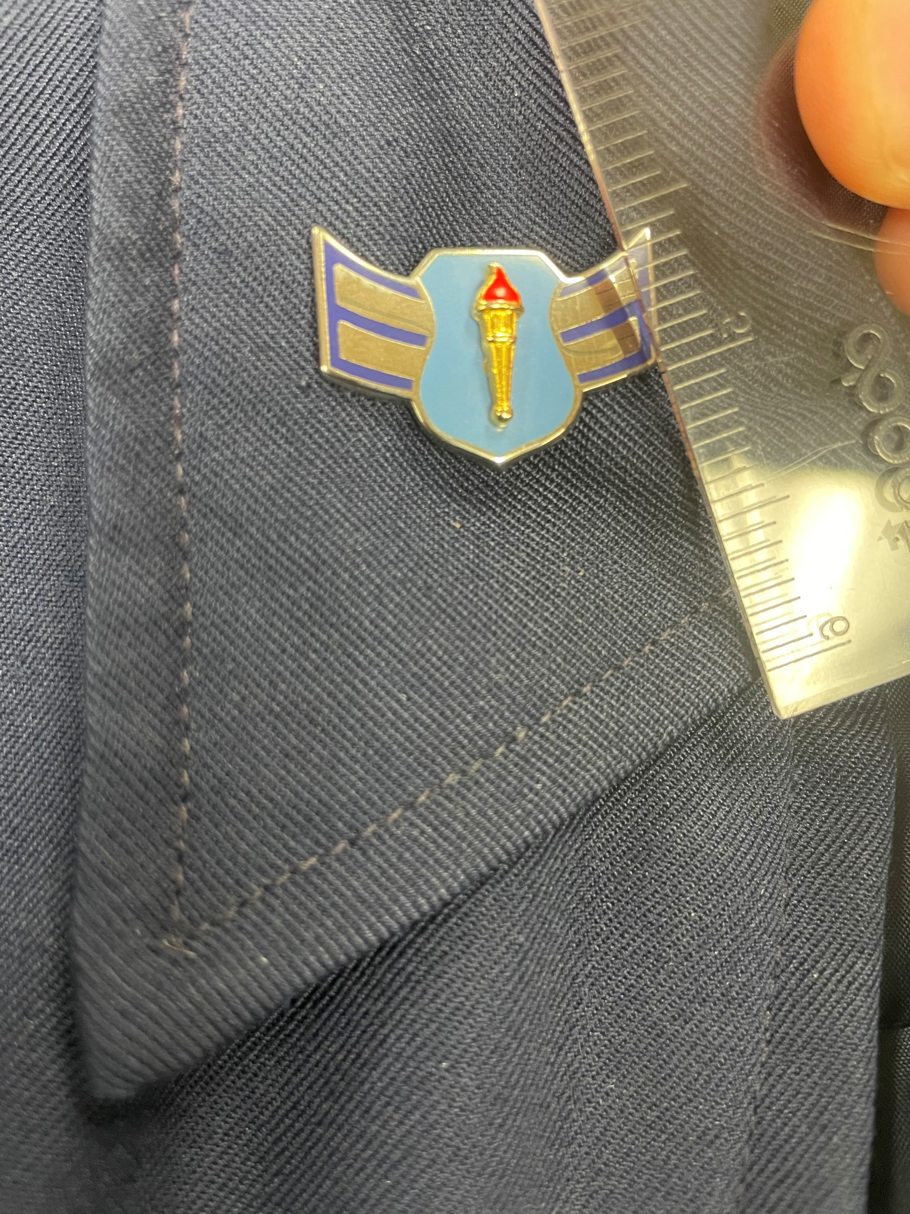

Slide 8
Gig line
What is it?
Alignment of 3 things:
Edge of shirt material
Curved edge of belt buckle (opposite
of silver tip)
Edge of pants zipper flap
Males insert belt into pants belt loops starting on the left
When fastened, the silver tip is on the wearer’s left
Females insert belt into pants loops going to the right
When fastened, the silver tip is on the wearer’s right
Don’t miss any belt loops

Slide 9
Trousers Male pants
Dry clean only
Neatly pressed and free of stains, lint, and cables.
Male pants: Back left pocket button will be buttoned at all times
Unless quickly retrieving an item from that pocket

Slide 10
Flight Cap
Wear outside (put on as soon as step outside)
Do NOT wear inside
Worn slightly to the wearer's right with vertical creases of the cap in line with the center of the forehead and in a straight line with the nose.
The cap extends approximately 1 inch from the eyebrows in the front
If not worn,
Tuck under the belt on wearer’s left side, between the first and second belt loops
cap will not fold over belt or be visible below service coat

Slide 11
Don’t Forget
Grooming standards
Hair, nails, shave, earrings, necklaces, bracelets, etc
Plain black socks only
Dress shoes
Keep them on & laced up/tied
Shine your shoes
Watch where you walk
Neatly hang up uniform when not wearing
Be careful with eating, etc.
Wear all day at school
Take pride in your uniform and appearance

Slide 12
Exchanging Salutes
Why
Courteous exchange of greeting in uniform
Where
Outdoors only (outside of building)
Note: carry bookbag in left hand
Who
All enlisted initiate salute with officer
Lower ranking officer initiates salute w/higher ranking officer

Slide 13
Exchanging Salutes
How
Head and eyes are turned toward person saluted
The junior member should initiate the salute in time to allow the senior officer to return it
“Good morning/afternoon sir/ma’am”
Drop salute once returned
Note: Superior who is carrying articles in both hands need not return the salute, but he or she should nod in return or verbally acknowledge the salute.

Slide 15
Cadence
Cadence is the measure or beat of movement
Definition:
The uniform step and rhythm in marching; that is, the number of steps marched per minute
Quick Time
The rate of marching at 100 to 120 steps per minute (12 or 24 inches in length)

Slide 16
Cadence
The interval producing the best effect in a movement is the one
Allowing one step between the preparatory command and the command of execution.
Commands called while marching must be called when the heel strikes the ground and no other time

Slide 17
Cadence
Instructor counts cadence to help teach coordination and rhythm
To help keep in step, cadets should:
Keep the head up and watch the head and shoulders of the person directly in front of them
When cadets get out of step, the instructor either corrects them by:
Counting cadence
Halts the element and then moves them off in step
Cadence is given in sets of two as follows: HUT, TOOP, THREEP, FOURP; HUT, TOOP, THREEP, FOURP.
Must not drag out each word (why add p)
Must be short and precisely on the heel of each foot.

Slide 18
Cadence
The command for the element to count cadence is:
Count Cadence, COUNT.
Command of execution as the left foot strikes the ground
The next time the left foot strikes the ground, the group counts cadence for eight steps, as follows:
ONE, TWO, THREE, FOUR; ONE, TWO, THREE, FOUR
Do not shout the counts.
Give them sharply and clearly, and separate each number distinctly

Slide 19
Forward March and Halt

Slide 20
A Few Drill Standards
Steps & Marching
When executed from a halt, all steps & marching begin with left foot
Except right step (not learning today)
Quick time
24” steps measured from heel to heel
Coordinated Arm Swing
6” to the front
Measured from the rear of the hand to the front
of the thigh
3” to the rear
Measured from the front of the hand to the back
of the thigh
40” distance
Measured from the chest of the individual to the back of the individual directly in front

Slide 22
Dress Right Dress and Cover
Short choppy steps; 5, 4, 3, 2, 1, Done sir, Done

