Slide 1
CADET MISSION BRIEF Template | EXAMPLE
HQ AFJROTC

Slide 2
PREREQUISITES… getting started
Don’t Procrastinate -- Begin Early (approximately 2 Months from evaluation)
Attain Cadet Access to WINGS
Read Chapter 1 Cadet Operations Guide, Operational Supplement
Collect the following 6 mandatory unit items from the past 12 months:
Cadet Corps Goals and Measurements
Health and Wellness Info and Results
Community Service Info and Results
Curriculum In Action (CIA) Info and Results
Leadership Development Requirements (LDRs) Info and Results
List of School Activities, Clubs, Sports, etc. in which cadets participate
Photos of Cadets in Action {a picture is worth a thousand words}

Slide 3
PREPARATION
Identify Briefer {more than one highly recommended}
Create PowerPoint Presentation
- Must be Developed & Presented by CADETS
- Tell your units story (It’s okay to brag!) | Make it your own
- Use same design background for each slide
- Margins, fonts, font sizes, colors should be consistent throughout
- Idea font style: Arial, Tahoma, Veranda
- Idea font size: No smaller the 24 point
- Text colors: Dark on light backgrounds - Light on dark backgrounds
- {Optional} Can insert a cadets in action video up to 25 seconds in length
- Incorporate photos throughout as needed
Target briefing to no more than 20 slides

Slide 4
EXCEED THE STANDARD
HUGE: Don’t read each slide…talk about each slide!
Integrate units “best practices” in your briefing
Ensure data on slides reflect what’s in WINGS – DOUBLE CHECK
Be prepared to explain your supporting data when asked by the evaluator
Speak clearly and loud enough for evaluator to hear
Briefing should be polished and well rehearsed again and again
- First with fellow cadet staff members (several practice runs)
- Then with Instructor Team (multiple times)
- Lastly, with a School Administrator or an English Teacher (1 week out)
Aim to keep briefing under 35 minutes…allow time for questions & answers

Slide 5
THE BRIEFING
This is just an “example” of a
CADET MISSION BRIEF.
It includes all 6 mandatory and some optional* briefing items. You will need to CREATE YOUR OWN BRIEFING that tells your unit’s story.
* = Varies between units

Slide 6
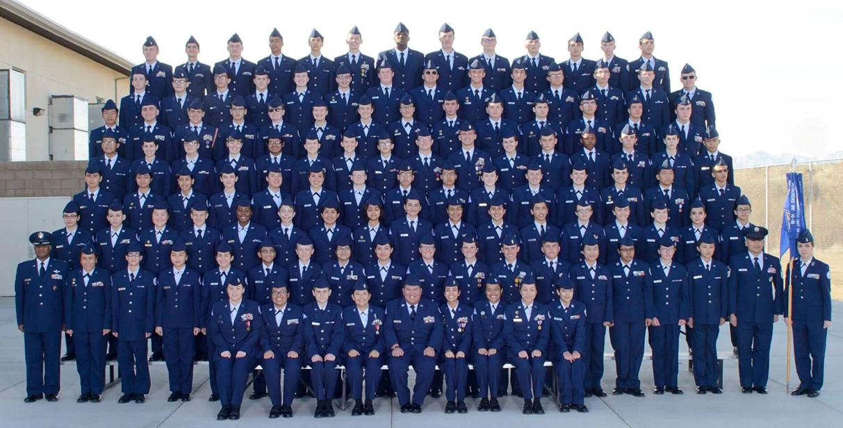
WELCOME TO ANY HIGH SCHOOL ZZ-001
Example Photo
Building a Culture of Excellence since XXXX!

Slide 7
OVERVIEW
Cadet Colonel Bill E. Goat - Commander
Unit Structure | Unit Summary {Optional}
Unit Goals and Performance Measurements (M)
Unit Health and Wellness Program (M)
Community Service Summary (M) Must include events with hours & cadet participation rates
Curriculum in Action (CIA) Trips (M) Must include cadet participation rates
Leadership Development Requirements (LDRs) (M) Must include cadet participation rates
Campus Activities, Clubs, Sports, etc. in which cadets participate (M)
Cadets in Action {Optional}
Summary {Optional}
NOTE: Items marked as (M) are MANDATORY and MUST be briefed and cover ONLY the past 12 months. Items marked as optional are highly encouraged and should relate to other UE key indicators.

Slide 8
UNIT STRUCTURE
OPTIONAL
Cadet Colonel Bill E. Goat - Commander
Overview: Describe how unit is organized, the enrollment, etc.
ZZ-001 | THE FLYING GENERALS (example)
Developing Citizens of Character for xx Years!
Group Commander C/Col Goat
Operations C/Maj Clampett
Mission Support C/Capt Munster
Logistics C/1LT Pyle
Special Teams C/Maj Austin
UNIT STRENGTH (example)
AY 202x-202x Enrollment: xxx Cadets assigned to x Flights
- Cadets By AS Level: AS-I: xx AS-II: xx AS-III: xx AS-IV: xx

Slide 9
UNIT SUMMARY
OPTIONAL
Cadet Colonel Bill E. Goat - Commander
Overview: Describe how cadet leaders operate on a day-to-day basics.
COMMAND & CONTROL (examples)
Leadership Structure within the Classroom
How cadet staff plans, organizes, and executes unit activities
How information is disseminated within the unit
Overview: Feature cadet grad rates and unit honors, praises, etc.
OTHER PERTINENT INFORMATION (examples)
Cadet graduation rate vs. Schools graduation rate
Accolades received from the community

Slide 10
UNIT Goals and measures
MANDATORY
Cadet Colonel Bill E. Goat - Commander
Overview: List your SMART goals. Need at least 2 Mandatory Goals – 1 must be academic and loaded in WINGS | Unit Information. MUST include performance measurements and current status.
CADET IMPACT GOALS (examples)
80% of unit will achieve a 2.5 GPA for each 9-week grading period
Measurement: Unit met goal for the 1st and 2nd 9-week grading periods with a 2.7 GPA. Awaiting release of 3rd 9-week grades. Unit is on target to achieving goal by the end of the school year.
2. Increase unit PFT scores by 10 points from initial test to final test in Apr 202x
Measurement: Kept weekly fitness logs, cadet PTLs focused on weakest areas; strength and endurance. Unit PFT scores improved from a 39 point average in Sep 202x to 51 point average in Apr 202z.

Slide 11
UNIT Goals and measures
MANDATORY
Cadet Colonel Bill E. Goat - Commander
Overview: List your SMART goals. Need at least 2 Mandatory Goals – 1 must be recruiting and retention and loaded in WINGS | Unit Information. MUST include performance measurements and current status.
SCHOOL IMPACT GOALS (examples)
Each flight will perform X service events to the school by 1 Apr 202x
Measurement: Flights were tasked to organize weekly plans to raise and
lower the US Flag from the flagpole on school days. We have completed XX events to include adding XX hours of community service.
2. Conduct recruiting activity at feeder schools before end of school year
Measurement: The corps commander addressed XXX eighth graders at 2 schools about AFJROTC. Our LDR teams performed short demonstrations. 100% contact was achieved and XX students expressed interest in joining AFJROTC next school year.

Slide 12
UNIT Goals and measures
MANDATORY
Cadet Colonel Bill E. Goat - Commander
Overview: List your SMART goals. Need at least 2 Mandatory Goals – 1 must be oriented to cadet involvement and loaded in WINGS | Unit Information. MUST include performance measurements and current status.
COMMMUNITY IMPACT GOALS (examples)
Each cadet will average xx hours of service from 11 Apr 202x to 10 Apr 202x
Measurement: Unit has achieved xxx hours of community service, xx hours above of our goal. The unit is averaging xx hours per cadet.
2. 95% of unit will participate in all 3 city-wide parades by end of 1st Semester
Measurement: Cadet planning committee organized and executed the community service events. The corps had a participation rate of 100% for Veteran’s Day parade, 95% for Thanksgiving parade, and 97% for Christmas parade. The unit goal met with 97.3% average.

Slide 13
UNIT health and wellness
MANDATORY
Cadet Captain Mick E. Mouse - Fitness Manager
Overview: Summarize your unit PT/Wellness program, MUST include PFT mass assessments.
PURPOSE (example)
Improve cadet’s well-being through physical activities
Promote a healthier lifestyle
FITNESS ASSESSMENT (example)
Total Number of Cadets Tested: xxx
Tested on all 3 components: Push-ups | Sit-ups | 1-Mile Run
Testing completed on DD-MM-YY
Loaded in WINGS | Wellness PFT MASS on DD-MM-YY
Gold-Stars Earned: x | Silver-Stars Earned: x | Bronze-Stars Earned: x

Slide 14
UNIT health and wellness
MANDATORY
Cadet Captain Mick E. Mouse - Fitness Manager
Overview: Summarize your unit PT/Wellness program, MUST include PFT mass assessments.
PARENTAL CONSENT FORMS (example)
Signed by parent/guardian before cadet can participate in any PT activity
Properly annotated (circled) YES or NO throughout form
100% Accountability ~ Forms loaded in WINGS | Wellness
Hard-copy maintained in _______________________
PT DAYS and ACTIVITIES (example)
Lead by Physical Training Leaders in each Flight every Friday
Activities Include: Running, Calisthenics, Circuits, PT UNO, Kickball, Volleyball
NOTE: You can enhance unit health and wellness slides with photos of cadets performing PT activities.

Slide 15
UNIT community service
MANDATORY
Cadet Captain James T. Kirk - Project Officer
Overview: Summarize your community service events, MUST include total hours & participation rate.
ZZ-001 IN ACTION (example)
Amassed xxx service hours | xx% Cadet average | 11 Apr 202X – 10 Apr 202x
xxx Cadets performed xx events with xx% participation rate
ZZ-001 COMMUNITY EVENTS (example)
Parades, Nursing Home Visit, Adopt-a-Highway, Campus Clean-up, Read Across America, Wreaths Across America, Adopt-A-Family, Can Food Drive, Blood Drive
All events planned/executed by cadets and loaded in WINGS | Events
NOTE: You can enhance unit community service slides with photos of cadets performing service activities.

Slide 16
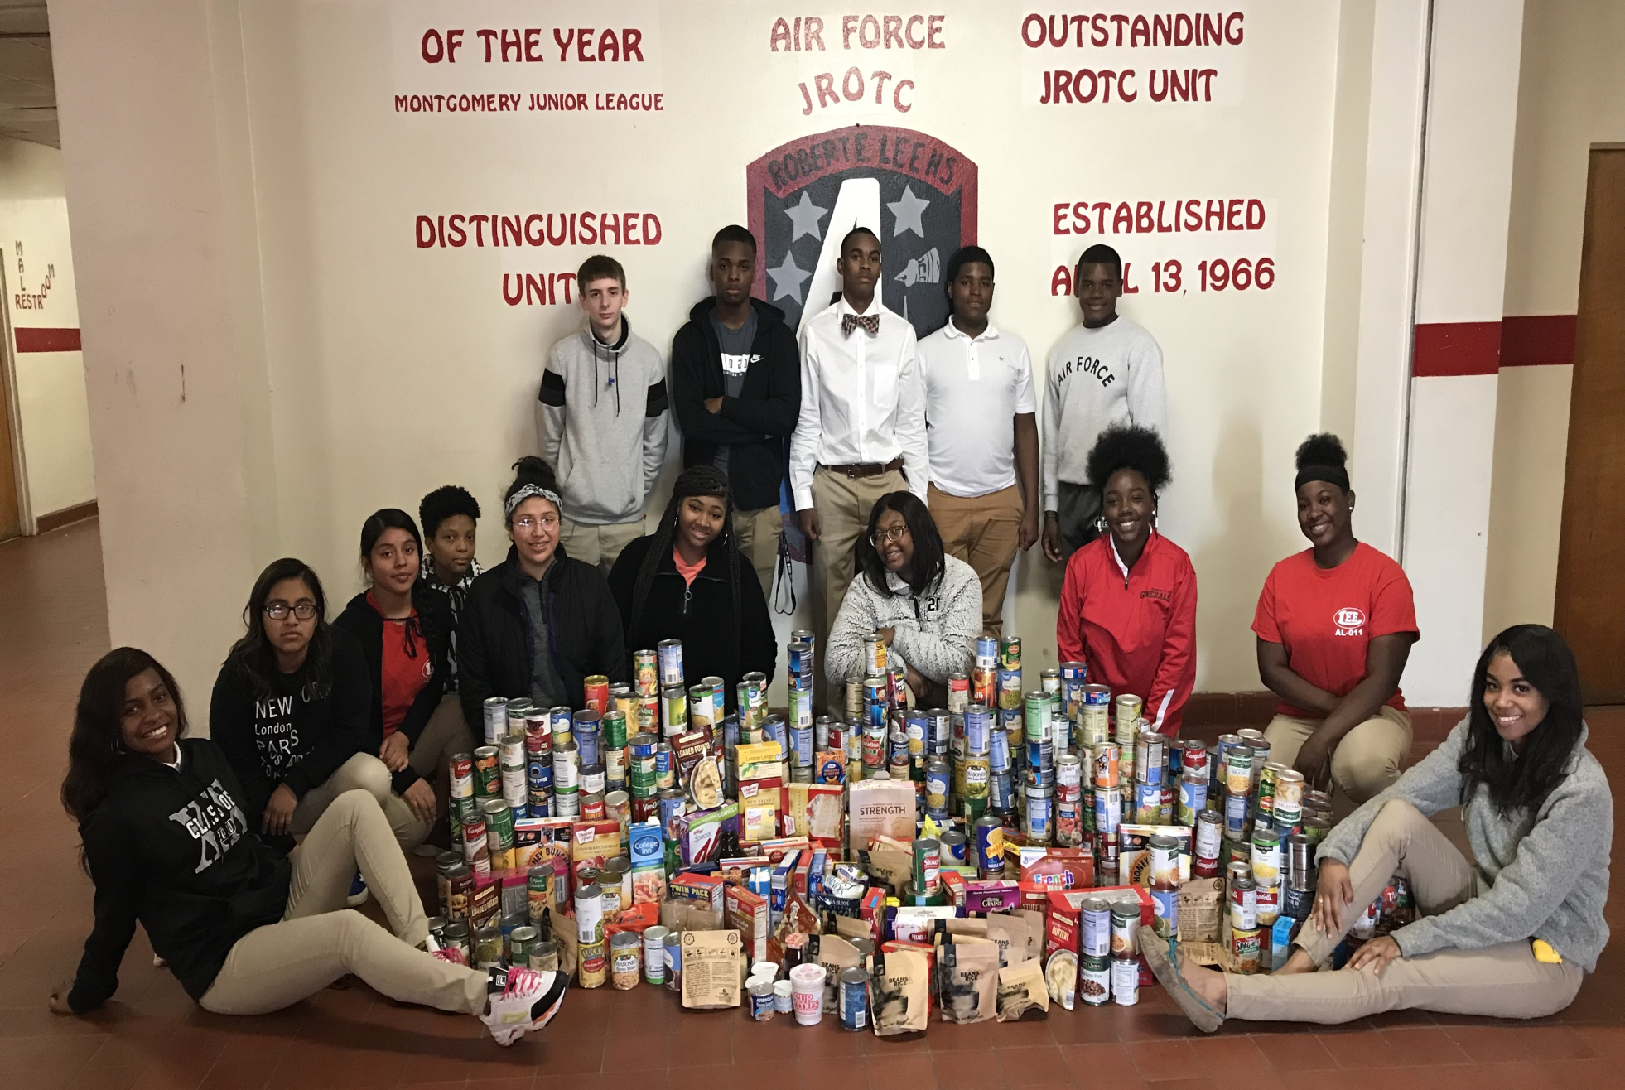
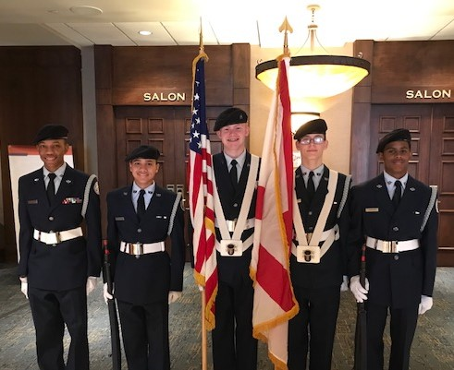
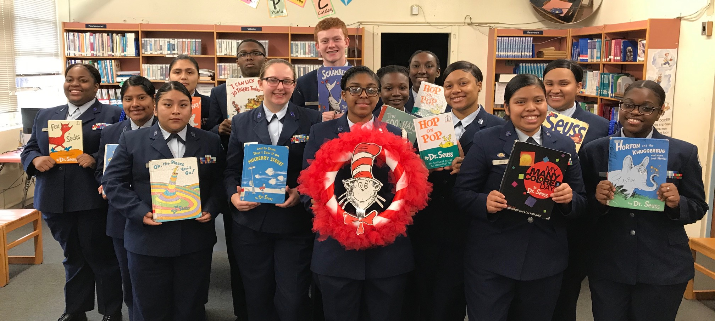
UNIT community service SUMMARY
Cadet Captain James T. Kirk - Project Officer
PARADES
CAN FOOD DRIVE
COLOR GUARD REQUEST
READ ACROSS AMERICA
Example Photos

Slide 17
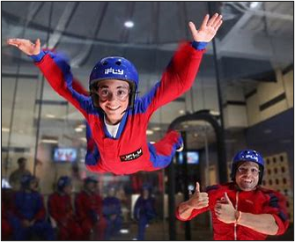
UNIT Curriculum in action (CIA)
MANDATORY
Cadet Captain Kangaroo - Planning Committee Chair
Overview: Summarize your CIA trips for upcoming school year, MUST include participation rate.
OUR CIA TRIPS (example)
Two CIA Trips planned this school year
1. Any Air Force Base Tour on xx Nov 202x
2. Space Museum in Any City, USA on xx Apr 202x
CIA TRIPS MISSION COMPLETE (example)
xx of xxx Cadets went on CIA Trip to Any Base (xx% participation rate)
CIA Trip loaded in WINGS | Events
Example Photo
NOTE: You can enhance unit CIA slides with photos of cadets participating on trip.

Slide 18
UNIT leadership development
MANDATORY
Requirements (ldrs)
Cadet Major Steve Austin - Special Teams Commander
Overview: List your unit LDRs, MUST include percentage of cadets that participate in at least 1 LDR.
ZZ-001 LDR ACTIVITIES (example)
STEM Based Tier 1
3 TEAMS
JLAB
Drones
Rocketry
Activity Based Tier 2
6 TEAMS
Drill Team x2
Color Guard
Marksmanship
Orienteering
Raiders
Unit Based Tier 3
4 TEAMS
Flag Detail Team
Green Team
Planning Committee
Kitty Hawk Honor Society
Ki
XX% of unit cadets participate in at least one LDR

Slide 19
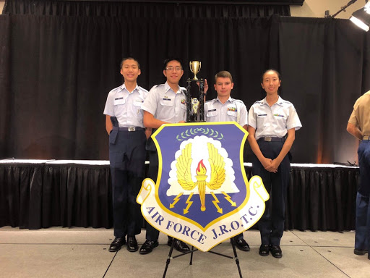
UNIT leadership development
MANDATORY
Requirements (ldrs)
Cadet Major Steve Austin - Special Teams Commander
Overview: Use subsequent slides to highlight individual LDRs as necessary.
LDR ACTIVITIES TIER 1 (example)
ACADEMIC BOWL TEAM
2x Finalists at Washington DC
3x Air Force National Champions
3x Joint Service National Champions
Competitions & practices loaded in WINGS | Events
Example Photo

Slide 20
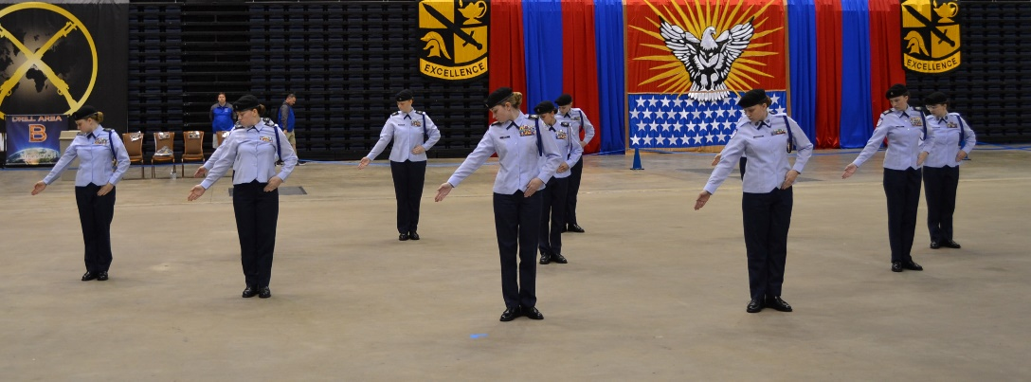
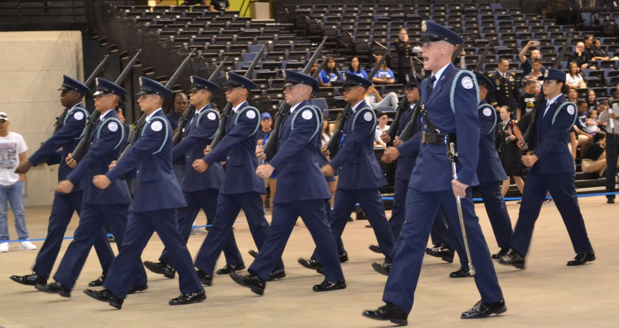
UNIT leadership development
MANDATORY
Requirements (ldrs)
Cadet Major Steve Austin - Special Teams Commander
Overview: Use subsequent slides to highlight individual LDRs as necessary.
LDR ACTIVITIES TIER 2 (example)
DRILL TEAMS
XX Cadets Participate on 2 Teams
- Unarmed and Armed
11 – 1st Place Trophies
9 – 2d Place Trophies
6 – 3d Place Trophies
Drill Meets & practices loaded in WINGS | Events
Example Photos

Slide 21
UNIT leadership development
MANDATORY
Requirements (ldrs)
Cadet Major Steve Austin - Special Teams Commander
Overview: Use subsequent slides to highlight individual LDRs as necessary.
LDR ACTIVITIES TIER 3 (example)
FLAG DETAIL TEAM
Raises and Lowers US Flag on school days
1 Team per Flight
Alternating Schedule
Each event loaded in WINGS | Events
Example Photo

Slide 22
cadets ACROSS campus
MANDATORY
Cadet Master Sergeant G.I. Joe – The Real American Hero
Overview: List other school activities i.e., sports, organizations, clubs, etc. in which cadets participate. MUST include number of participates.
SPORTS (example)
Football 9 cadets
Cheerleader 4 cadets
Volleyball 3 cadets
THE ARTS (example)
Band 13 cadets
Choir 3 cadets
Drama 1 cadet
ORGANIZATIONS (example)
National Honor Society 6 cadets
Student Government 3 cadets
Future Farmers of America 2 cadets
CLUBS (example)
Debate Team 2 cadets
Chess 1 cadet
NOTE: You can enhance slides with photos of cadets performing activities.

Slide 23
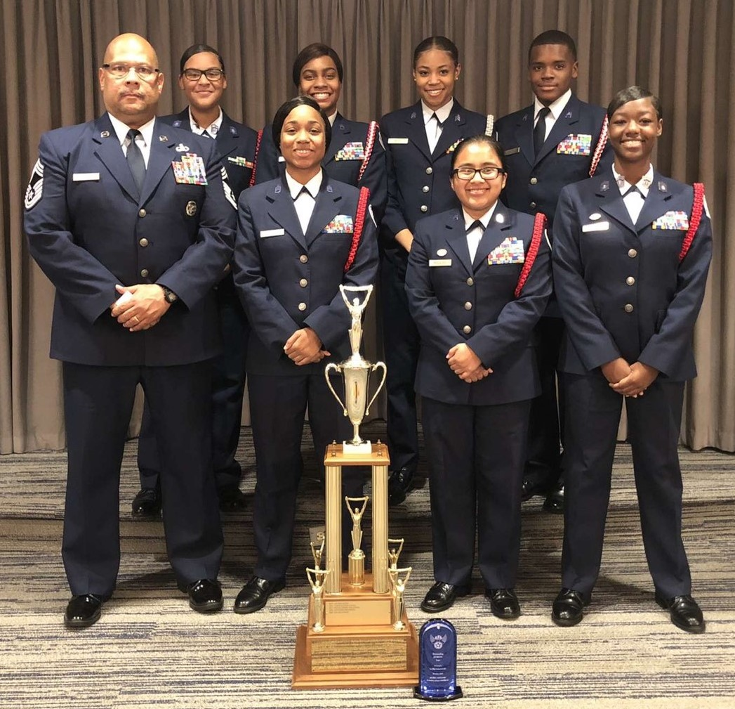
unit achievements
OPTIONAL
Cadet Lieutenant Colonel Charlie Brown - Deputy Commander
“WE ARE CONTINUOUS AWARD WINNERS!”
(examples)
#1 Unit in our State! AFA Chapter 102 Outstanding AFJROTC Unit of the Year Award
10x AFJROTC Distinguished Unit
Last Awarded: AY 202x-202x
2x AFJROTC Outstanding Organization
Last Awarded: AY 201x-201x
Example Photo

Slide 24
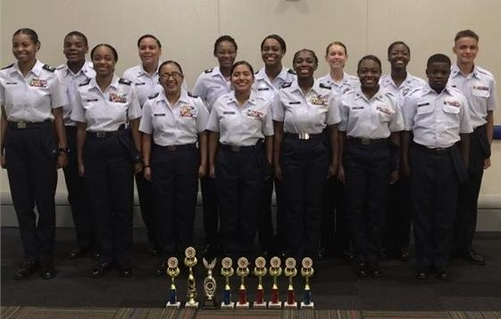
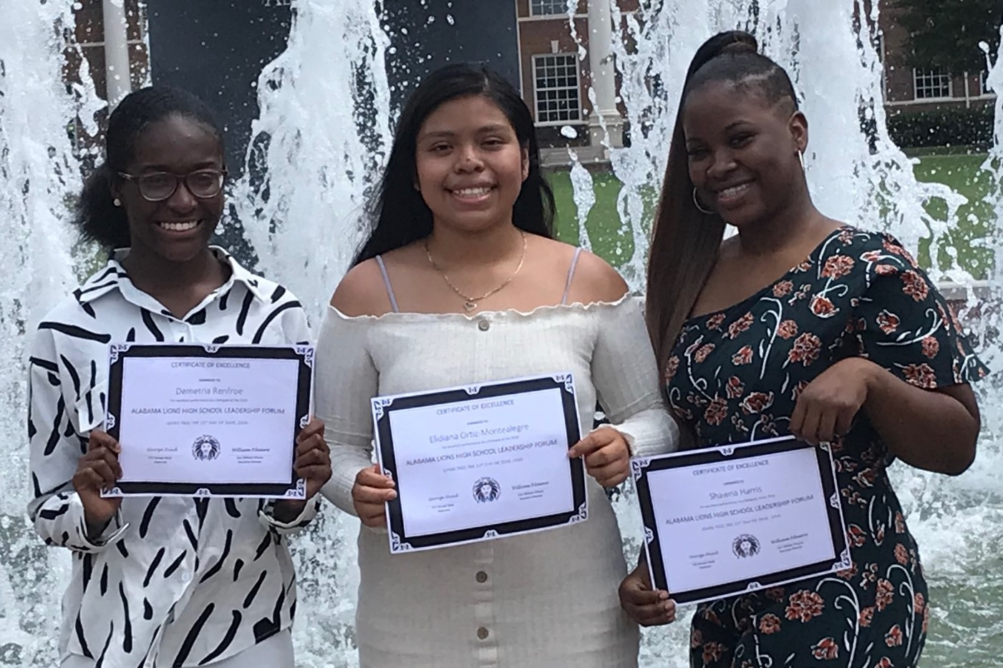
cadet accomplishments
OPTIONAL
Cadet Lieutenant Colonel Charlie Brown - Deputy Commander
“WE DEVELOP FUTURE LEADERS!”
(examples)
Cadets capture 9 Leadership Trophies at 202x CLC
v
Cadets attend LIONS CLUB Leadership Forum at State Univ
Example Photos

Slide 25
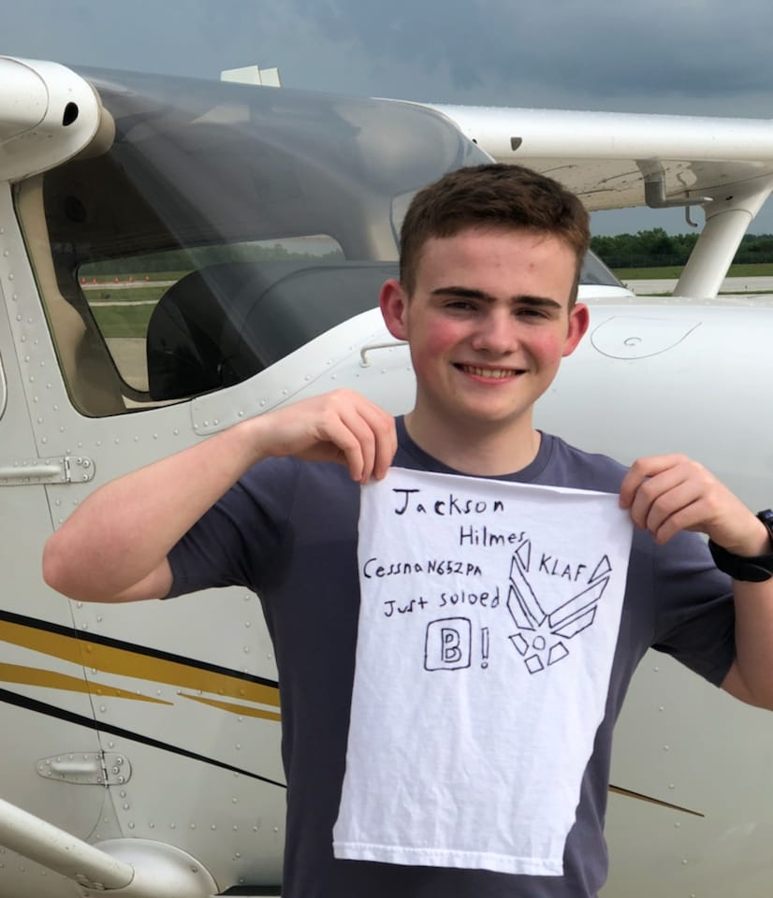
cadet accomplishments
OPTIONAL
Cadet Lieutenant Colonel Charlie Brown - Deputy Commander
“WE EARN SCHOLARSHIPS!”
“WE EARN WINGS TOO!”
Cadet Awarded 4 Year J-100 Scholarship to State University
Cadet Selected to Attend the Flight Academy this Summer
Example Photos

Slide 26
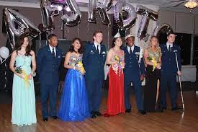
Cadets in action
OPTIONAL
Cadet Lieutenant Colonel Charlie Brown - Deputy Commander
“WE DO IT ALL And SO much more!”
(examples)
ACTIVITES YOU CAN HIGHLIGHT
RECRUTING and RETENTION EFFORTS
FUNDRAISING EFFORTS
FRESHMAN ORIENTATION
MILITARY BALL
ANNUAL AWARDS CEREMONY
SPORTS DAY
END-OF-YEAR PICNIC
MANY, MANY OTHERS
MILITARY BALL 202x
Example Photo
Highlight significant events/accomplishments from past year to current year.

Slide 27
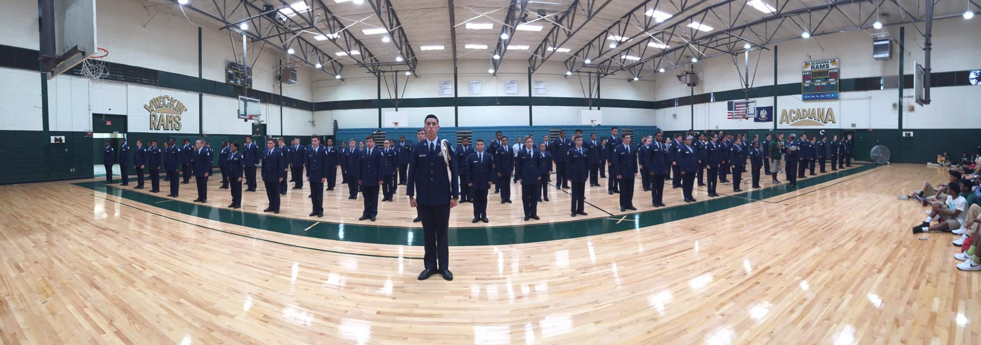
SUMMARY
OPTIONAL
Cadet Colonel Bill E. Goat
Summarize your briefing and give closing remarks
(example)
Example Photo

